Slide 1
Bayesian Networks

Slide 2
Burglars and Earthquakes
You are at a “Done with the AI class” party.
Neighbor John calls to say your home alarm has gone off (but
neighbor Mary doesn't).
Sometimes your alarm is set off by minor earthquakes.
Question: Is your home being burglarized?
Variables: Burglary, Earthquake, Alarm, JohnCalls, MaryCalls
Network topology reflects "causal" knowledge:
A burglar can set the alarm off
An earthquake can set the alarm off
The alarm can cause Mary to call
The alarm can cause John to call
•2

Slide 3
Example
Pearl lives in Los Angeles. It is a high-crime area. Pearl installed a burglar alarm. He asked his neighbors John & Mary to call him if they hear the alarm. This way he can come home if there is a burglary. Los Angeles is also earth-quake prone. Alarm goes off when there is an earth-quake.
Burglary => Alarm Earth-Quake => Alarm Alarm => John-calls Alarm => Mary-calls
If there is a burglary, will Mary call?
Check KB & E |= M
If Mary didn’t call, is it possible that Burglary occurred?
Check KB & ~M doesn’t entail ~B

Slide 4
Example (Real)
Burglary => Alarm Earth-Quake => Alarm Alarm => John-calls Alarm => Mary-calls
If there is a burglary, will Mary call?
Check KB & E |= M
If Mary didn’t call, is it possible that Burglary
occurred?
Check KB & ~M doesn’t entail ~B
John already called. If Mary also calls, is it more likely that Burglary occurred?
You now also hear on the TV that there was an earthquake. Is Burglary more or less likely now?
Pearl lives in Los Angeles. It is a high- crime area. Pearl installed a burglar alarm. He asked his neighbors John & Mary to call him if they hear the alarm. This way he can come home if there is a burglary. Los Angeles is also earth- quake prone. Alarm goes off when there is an earth-quake.
Pearl lives in real world where (1) burglars can sometimes disable alarms
(2) some earthquakes may be too slight to cause alarm (3) Even in Los Angeles, Burglaries are more likely than Earth Quakes (4) John and Mary both have their own lives and may not always call when the alarm goes off (5) Between John and Mary, John is more of a slacker than Mary.(6) John and Mary may call even without alarm going off

Slide 5

How do we handle Real Pearl?
• Om
•Potato in the tail-pipe
niscient & Eager way:
– Model everything!
Ignorant (non-omniscient) and Lazy (non-omnipotent) way:
Model the likelihood
In 85% of the worlds where there was an alarm, John will actually call
How do we do this?
E.g. Model exactly the conditions under which John will call
He shouldn’t be listening to loud music, he hasn’t gone on an errand, he didn’t recently have a tiff with Pearl etc etc.
A & c1 & c2 & c3 &..cn => J (also the exceptions may have
interactions
c1&c5 => ~c9 )
Non-monotonic logics
“certainty factors”
“fuzzy logic”
“probability” theory?
Qualification and Ramification problems make this an infeasible enterprise

Slide 6
Bayes Nets
•In general, joint distribution P over set of variables (X₁ x ... x X_{n}) requires exponential space for representation & inference
•BNs provide a graphical representation of
conditional independence relations in P
– usually quite compact
– requires assessment of fewer parameters, those being quite natural (e.g., causal)
– efficient (usually) inference: query answering and
belief update
•6

Slide 7
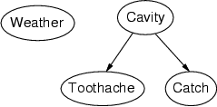
Back at the dentist’s
Topology of network encodes conditional independence assertions:
Weather is independent of the other variables
Toothache and Catch are conditionally independent of each
other given Cavity
•7

Slide 8
Syntax
a set of nodes, one per random variable
a directed, acyclic graph (link ≈"directly influences")
a conditional distribution for each node given its parents: P (X_{i} | Parents (X_{i}))
– For discrete variables, conditional probability table (CPT)=
distribution over X_{i} for each combination of parent values
•8

Slide 9
Burglars and Earthquakes
Pr(E=t) Pr(E=f)
0.002 0.998
Earthquake Burglary
Pr(B=t) Pr(B=f) 0.001 0.999
Pr(A|E,B) e,b 0.95 (0.05)
e,b
e,b
e,b
Pr(JC|A) a 0.9 (0.1)
Alarm
0.29 (0.71)
0.94 (0.06)
0.001 (0.999)
a 0.05 (0.95)
Pr(MC|A) a 0.7 (0.3)
a 0.01 (0.99)
JohnCalls
MaryCalls
•9

Slide 10
Earthquake Example (cont’d)
Earthquake
Burglary
Alarm
JohnCalls MaryCalls
If we know Alarm, no other evidence influences our degree of belief in JohnCalls
P(JC|MC,A,E,B) = P(JC|A)
also: P(MC|JC,A,E,B) = P(MC|A) and P(E|B) = P(E)
By the chain rule we have
P(JC,MC,A,E,B) = P(JC|MC,A,E,B) ·P(MC|A,E,B)·
P(A|E,B) ·P(E|B) ·P(B)
= P(JC|A) ·P(MC|A) ·P(A|B,E) ·P(E) ·P(B)
Full joint requires only 10 parameters (cf. 32)

Slide 11
Earthquake Example (Global Semantics)
Earthquake
Burglary
Alarm
JohnCalls MaryCalls
We just proved
P(JC,MC,A,E,B) = P(JC|A) ·P(MC|A) ·P(A|B,E) ·P(E) ·P(B)
In general full joint distribution of a Bayes net is defined as
P( X 1, X 2,..., Xn) = ∏ P( Xi | Par( Xi))
i=1
n

Slide 12
BNs: Qualitative Structure
Graphical structure of BN reflects conditional independence among variables
Each variable X is a node in the DAG
Edges denote direct probabilistic influence
usually interpreted causally
parents of X are denoted Par(X)
Local semantics: X is conditionally independent of all nondescendents given its parents
Graphical test exists for more general independence
“Markov Blanket”

Slide 13
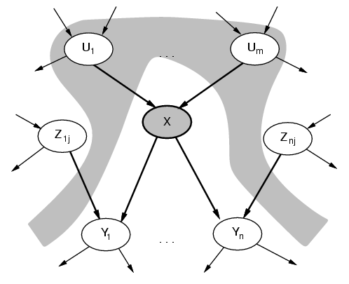
Given Parents, X is Independent of
Non-Descendants

Slide 14
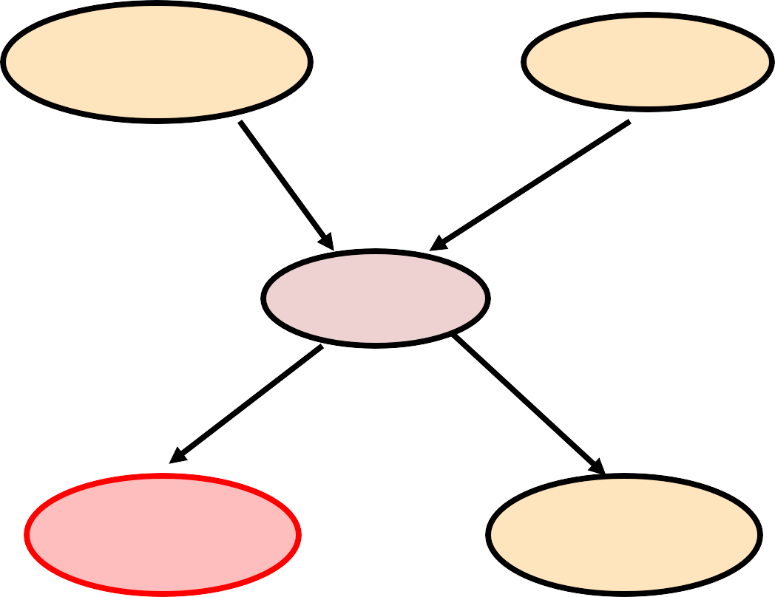
Examples
Earthquake
Burglary
Alarm
JohnCalls
MaryCalls

Slide 15
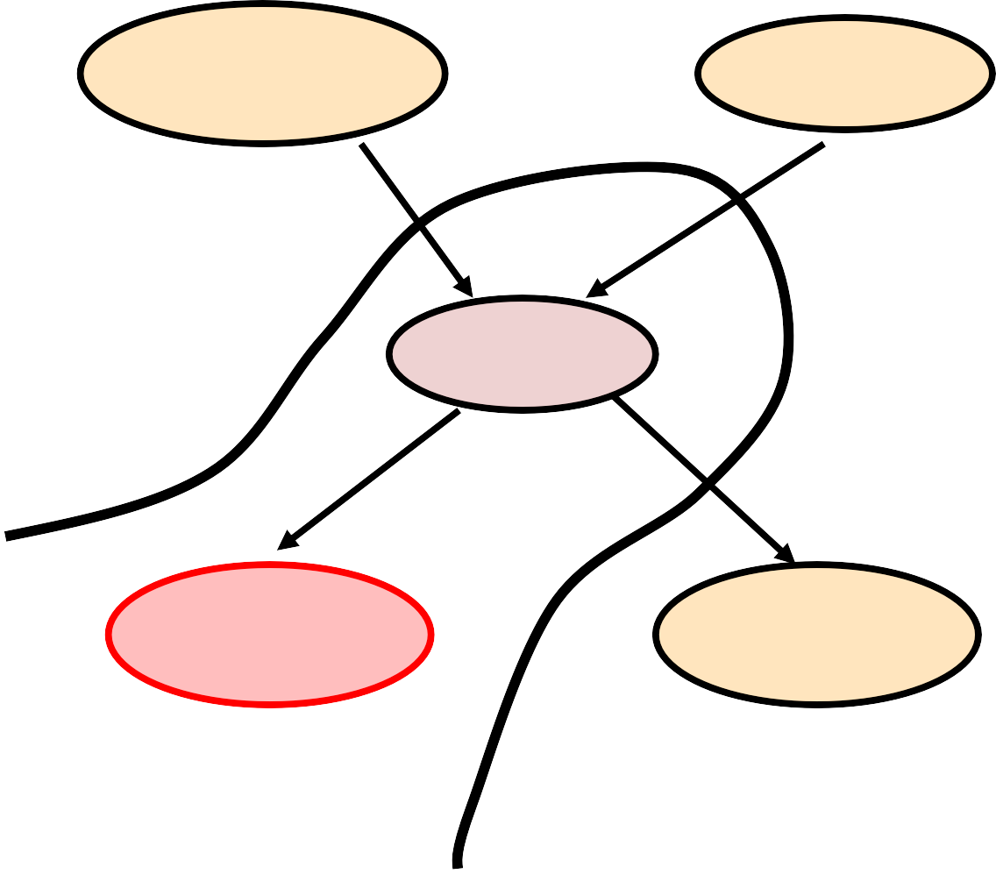
For Example
Earthquake
Burglary
Alarm
JohnCalls
MaryCalls

Slide 16
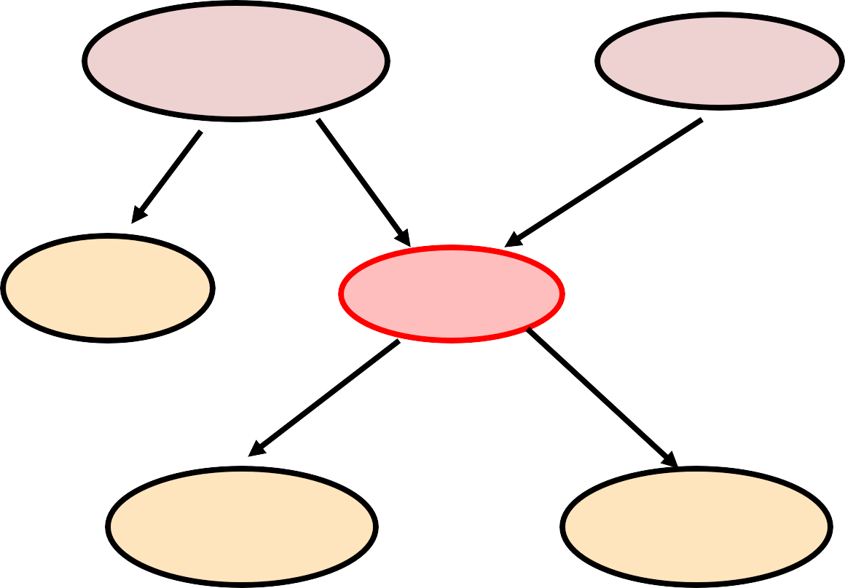
For Example
Earthquake
Burglary
Radio
Alarm
JohnCalls
MaryCalls

Slide 17
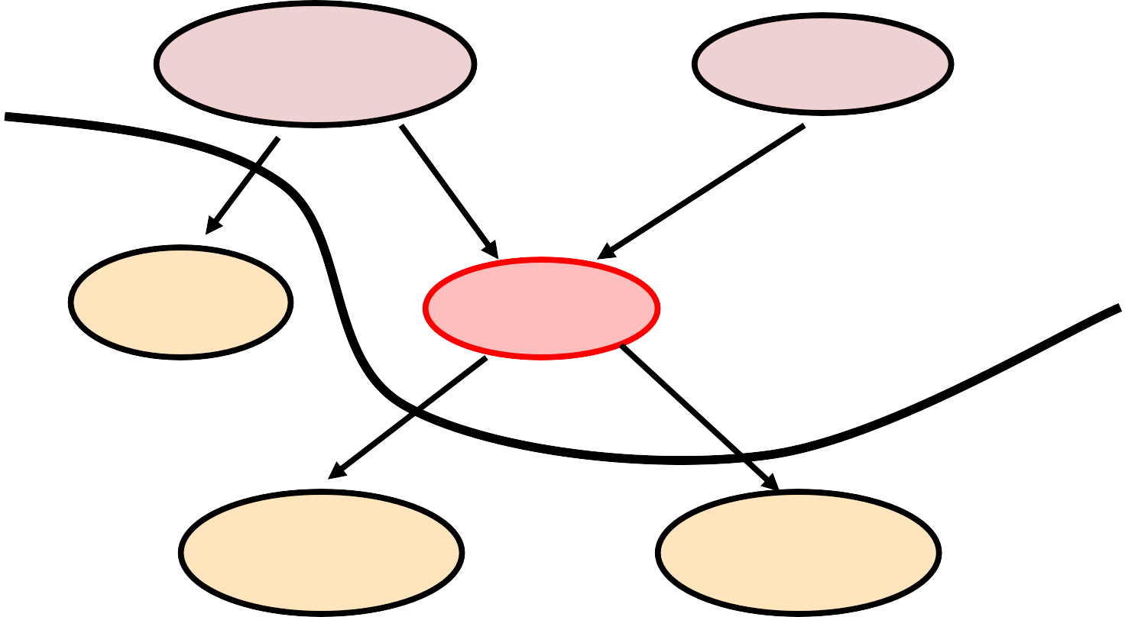
For Example
Earthquake
Burglary
Radio
Alarm
JohnCalls
MaryCalls
•© D. Weld and D. Fox

Slide 18
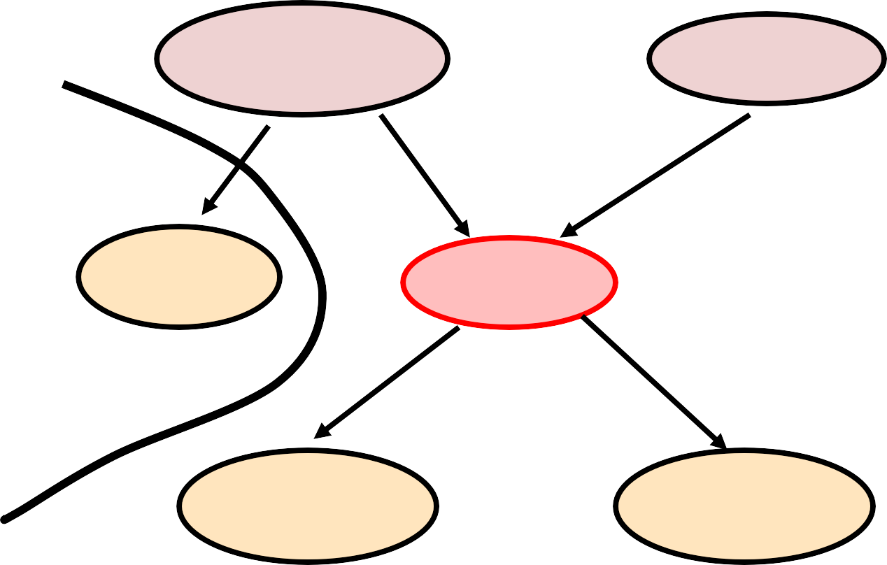
For Example
Earthquake
Burglary
Radio
Alarm
JohnCalls
MaryCalls
•© D. Weld and D. Fox

Slide 19
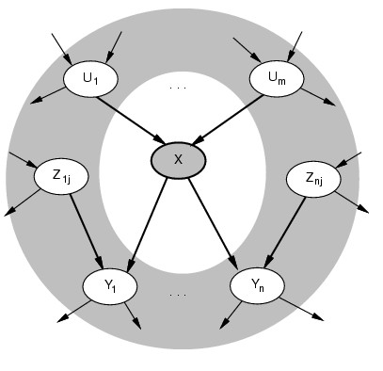
Given Markov Blanket, X is Independent of All Other Nodes
MB(X) = Par(X) ∪ Childs(X) ∪ Par(Childs(X))
•© D. Weld and D. Fox

Slide 20
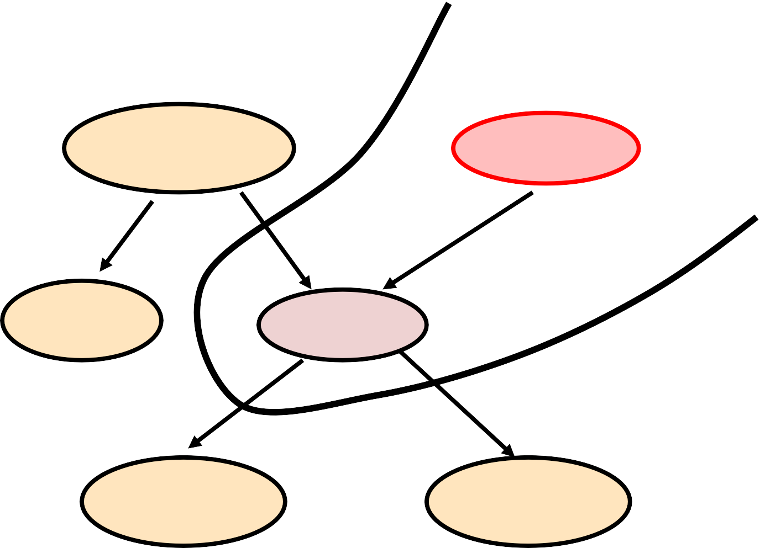
For Example
Earthquake
Burglary
Radio
Alarm
JohnCalls
MaryCalls
•© D. Weld and D. Fox

Slide 21
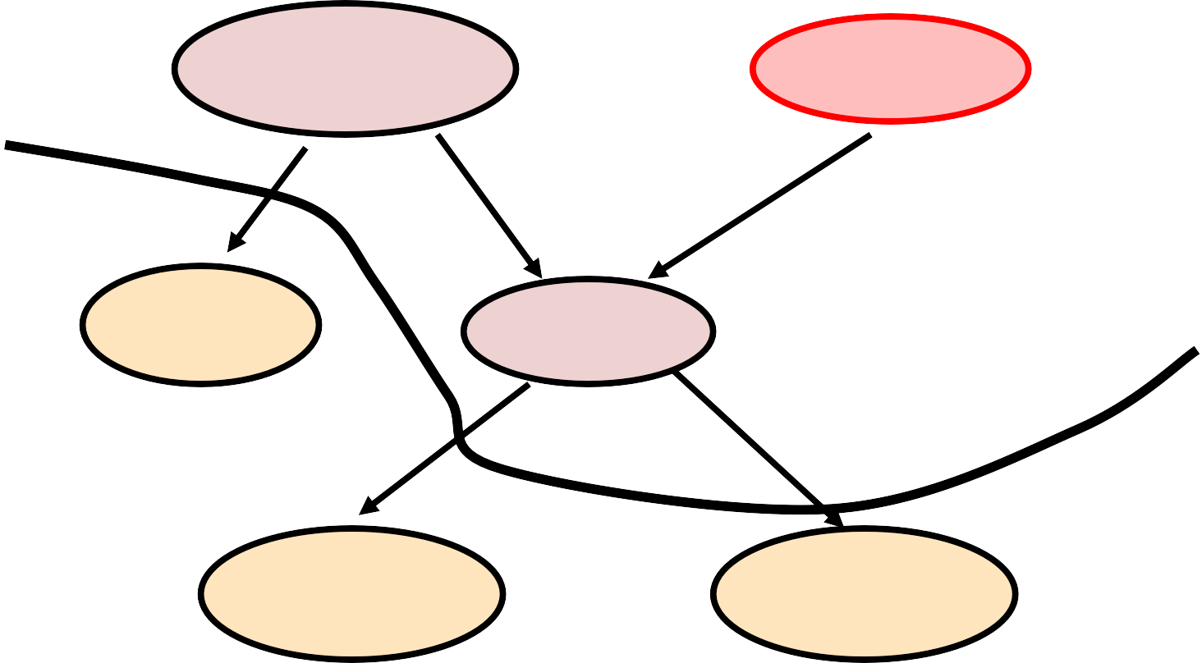
For Example
Earthquake
Burglary
Radio
Alarm
JohnCalls
MaryCalls
•© D. Weld and D. Fox

Slide 22
d-Separation
An undirected path between two nodes is “cut off” if information cannot flow across one of the nodes in the path
Two nodes are d-separated if every undirected
path between them is cut off
Two sets of nodes are d-separated if every pair of nodes, one from each set, is d-separated

Slide 23
d-Separation
A
B
C
Linear connection: Information can flow between A and C if and only if we do not have evidence at B

Slide 24
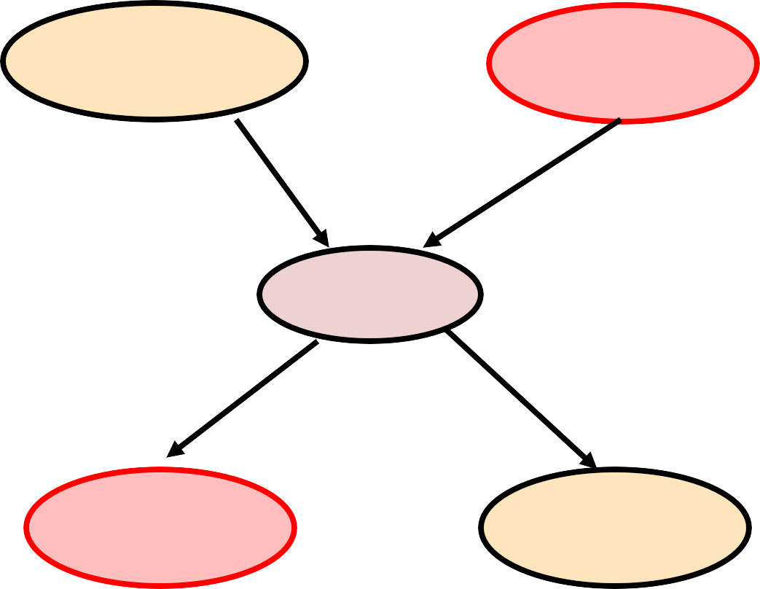
For Example
Earthquake
Burglary
Alarm
JohnCalls
MaryCalls
•© D. Weld and D. Fox
•24

Slide 25
d-Separation (continued)
A
B
C
Diverging connection: Information can flow between A and C if and only if we do not have evidence at B

Slide 26
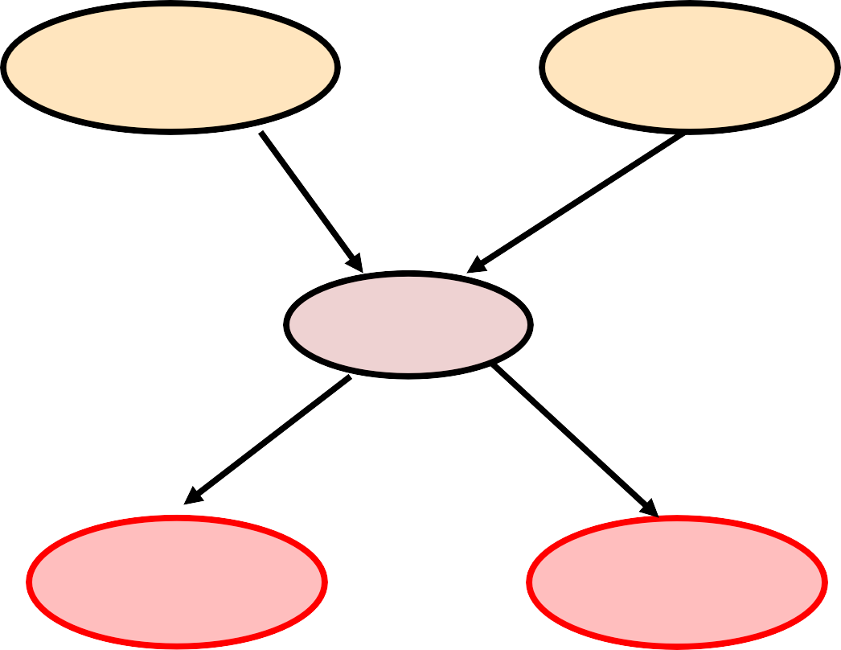
For Example
Earthquake
Burglary
Alarm
JohnCalls
MaryCalls
•© D. Weld and D. Fox
•26

Slide 27
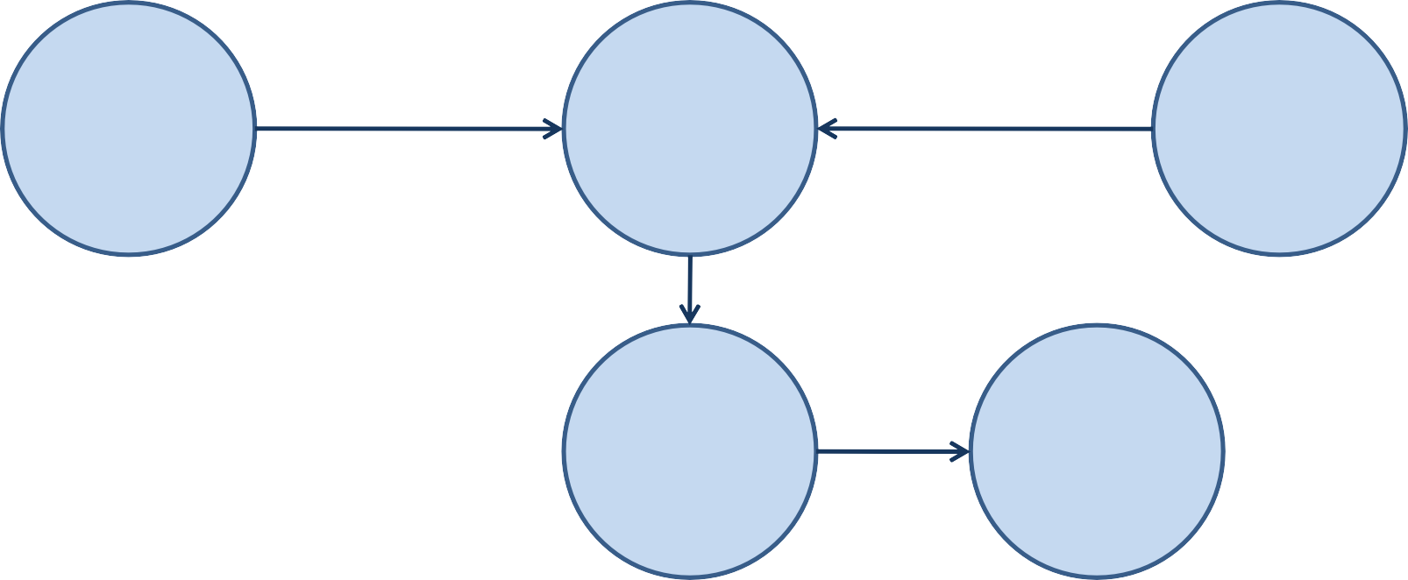
d-Separation (continued)
A
B
C
D E
Converging connection: Information can flow between A and C if and only if we do have evidence at B or any descendent of B (such as D or E)

Slide 28
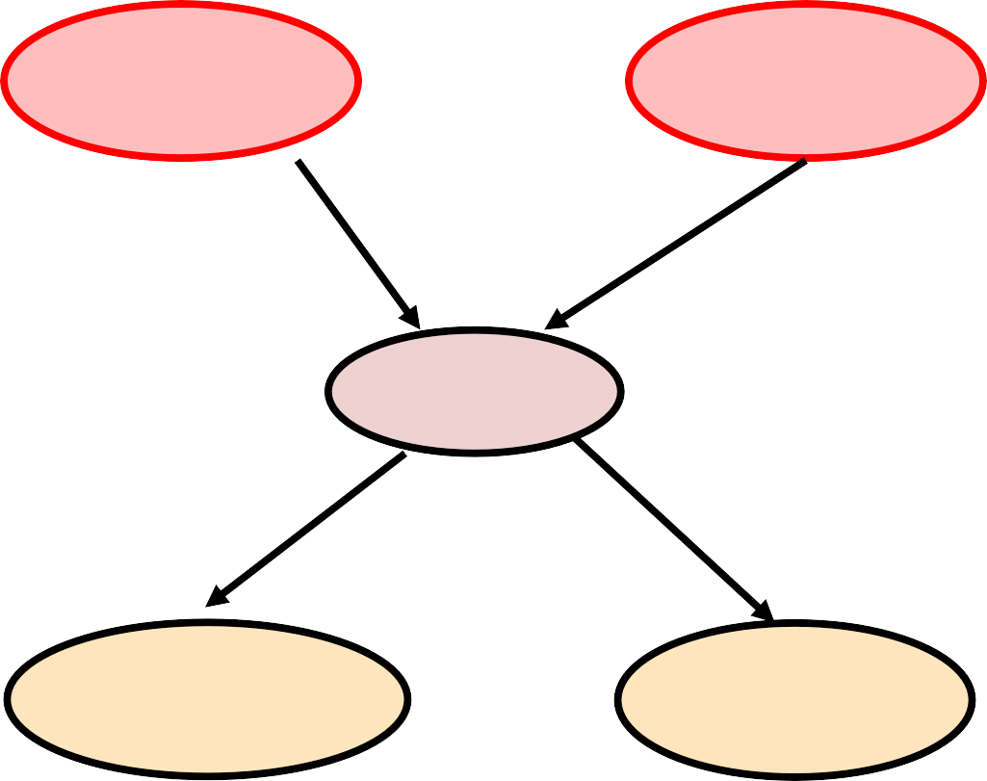
For Example
Earthquake
Burglary
Alarm
JohnCalls
MaryCalls
•© D. Weld and D. Fox
•28

Slide 29
d-Separation
An undirected path between two nodes is “cut off” if information cannot flow across one of the nodes in the path
Two nodes are d-separated if every undirected
path between them is cut off
Two sets of nodes are d-separated if every pair of nodes, one from each set, is d-separated

Slide 30
Note: For Some CPT Choices, More Conditional Independences May Hold
Suppose we have:
A B C
Then only conditional independence we have is:
P(A C | B)
Now choose CPTs such that A must be True, B must take same value as A, and C must take same value as B
In the resulting distribution P, all pairs of variables are conditionally independent given the third

Slide 31
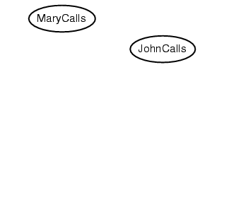
Bayes Net Construction Example
Suppose we choose the ordering M, J, A, B, E
P(J | M) = P(J)?
•© D. Weld and D. Fox

Slide 32
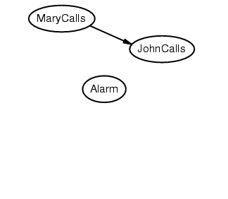
Example
Suppose we choose the ordering M, J, A, B, E
P(J | M) = P(J)?
No
P(A | J, M) = P(A | J)? P(A | M)? P(A)?
•© D. Weld and D. Fox

Slide 33
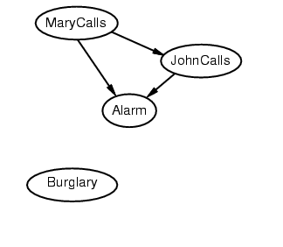
Example
Suppose we choose the ordering M, J, A, B, E
P(J | M) = P(J)?
No
P(A | J, M) = P(A | J)? P(A | J, M) = P(A)? No
P(B | A, J, M) = P(B | A)?
P(B | A, J, M) = P(B)?
•© D. Weld and D. Fox

Slide 34
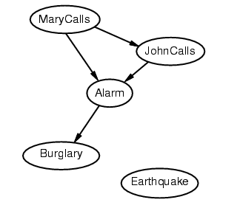
Example
Suppose we choose the ordering M, J, A, B, E
P(J | M) = P(J)?
No
P(A | J, M) = P(A | J)? P(A | J, M) = P(A)? No
P(B | A, J, M) = P(B | A)? Yes
P(B | A, J, M) = P(B)? No
P(E | B, A ,J, M) = P(E | A)?
P(E | B, A, J, M) = P(E | A, B)?
•© D. Weld and D. Fox

Slide 35
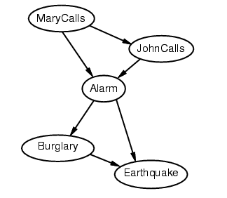
Example
Suppose we choose the ordering M, J, A, B, E
P(J | M) = P(J)?
No
P(A | J, M) = P(A | J)? P(A | J, M) = P(A)? No
P(B | A, J, M) = P(B | A)? Yes
P(B | A, J, M) = P(B)? No
P(E | B, A ,J, M) = P(E | A)? No
P(E | B, A, J, M) = P(E | A, B)? Yes
•© D. Weld and D. Fox

Slide 36
Example contd.
Deciding conditional independence is hard in noncausal directions
(Causal models and conditional independence seem hardwired for humans!)
Network is less compact: 1 + 2 + 4 + 2 + 4 = 13 numbers needed
•© D. Weld and D. Fox

Slide 37
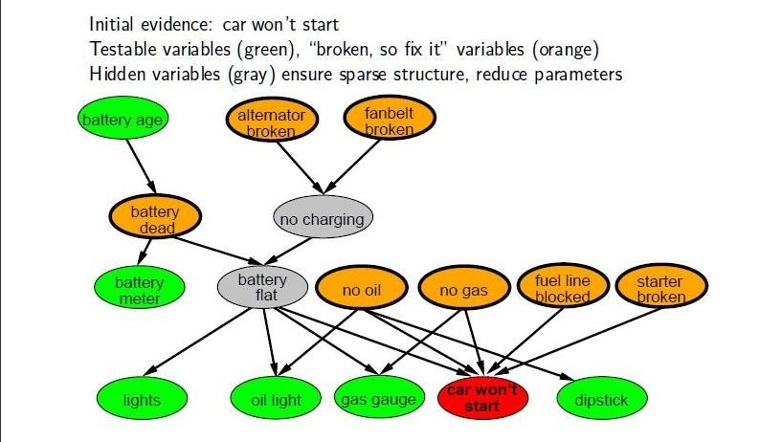
Example: Car Diagnosis
•© D. Weld and D. Fox

Slide 38
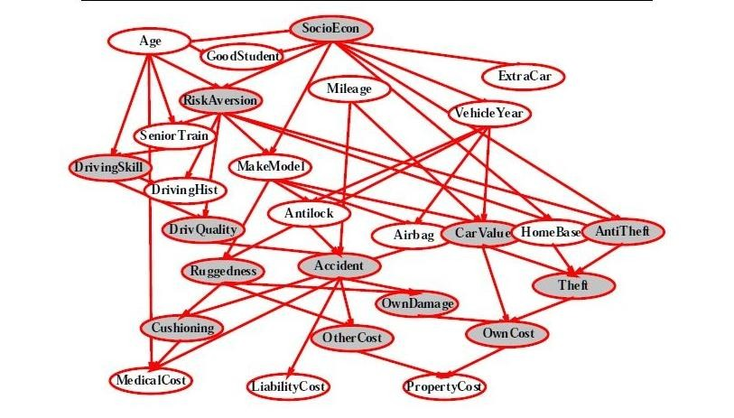
Example: Car Insurance
•© D. Weld and D. Fox

Slide 39
Other Applications
Medical Diagnosis
Computational Biology and Bioinformatics
Natural Language Processing
Document classification
Image processing
Decision support systems
Ecology & natural resource management
Robotics
Forensic science…_{•© D. Weld and D. Fox}
•40

Slide 40
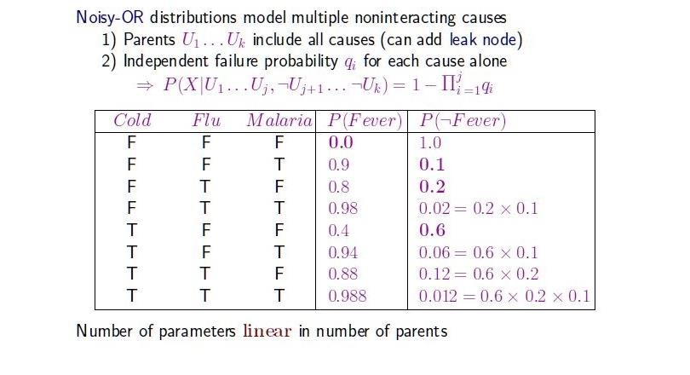
Compact Conditionals
•© D. Weld and D. Fox
•42

Slide 41
Inference in BNs
•The graphical independence representation
– yields efficient inference schemes
•We generally want to compute
– Marginal probability: Pr(Z),
– Pr(Z|E) where E is (conjunctive) evidence
Z: query variable(s),
E: evidence variable(s)
everything else: hidden variable
•Computations organized by network topology
•© D. Weld and D. Fox

Slide 42
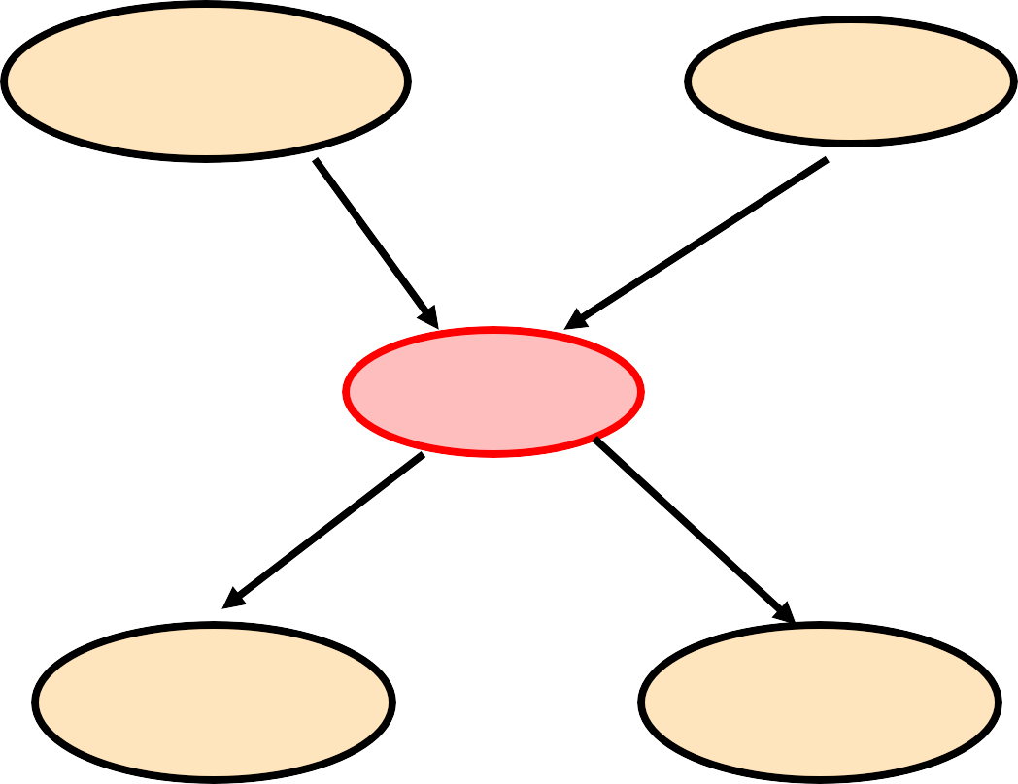
P(B | J=true, M=true)
Earthquake Burglary
Alarm
JohnCalls MaryCalls
P(b|j,m) = α Σ P(b,j,m,e,a)
e,a
•© D. Weld and D. Fox

Slide 43
P(B | J=true, M=true)
Earthquake Burglary
Alarm
JohnCalls MaryCalls
P(b|j,m) = αP(b) ΣP(e) ΣP(a|b,e)P(j|a)P(m|a)
e a
•© D. Weld and D. Fox

Slide 44
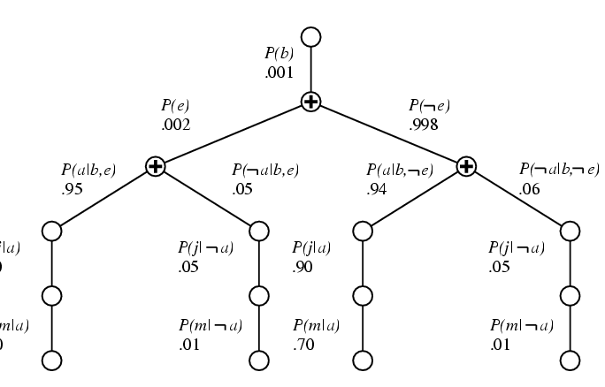

Variable Elimination
P(b|j,m) = αP(b) Σ_{e} P(e) Σ_{a} P(a|b,e)P(j|a)P(m,a)
Repeated computations ➔ Dynamic Programming
•© D. Weld and D. Fox

Slide 45
Variable Elimination
•A factor is a function from some set of variables into a specific value: e.g., f(E,A,N1)
– CPTs are factors, e.g., P(A|E,B) function of A,E,B
•VE works by eliminating all variables in turn until there is a factor with only query variable
•To eliminate a variable:
– join all factors containing that variable (like DB)
– sum out the influence of the variable on new factor
– exploits product form of joint distribution
•© D. Weld and D. Fox

Slide 46
Example of VE: P(JC)
P(J)
= Σ_{M,A,B,E} P(J,M,A,B,E)
= Σ_{M,A,B,E} P(J|A)P(M|A) P(B)P(A|B,E)P(E)
= Σ_{A}P(J|A) Σ_{M}P(M|A) Σ_{B}P(B) Σ_{E}P(A|B,E)P(E)
= Σ_{A}P(J|A) Σ_{M}P(M|A) Σ_{B}P(B) f1(A,B)
= Σ_{A}P(J|A) Σ_{M}P(M|A) f2(A)
= Σ_{A}P(J|A) f3(A)
= f4(J)
Burgl
Earthqk
Alarm
JC
MC
•© D. Weld and D. Fox

Slide 47
Notes on VE
•Each operation is a simple multiplication of factors and summing out a variable
•Complexity determined by size of largest factor
– in our example, 3 vars (not 5)
– linear in number of vars,
– exponential in largest factor elimination ordering greatly
impacts factor size
– optimal elimination orderings: NP-hard
– heuristics, special structure (e.g., polytrees)
•Practically, inference is much more tractable using
structure of this sort •© D. Weld and D. Fox
•54

Slide 48
Earthquake
Burglary
Irrelevant variables
Alarm
P(J)
= Σ_{M,A,B,E} P(J,M,A,B,E)
= Σ_{M,A,B,E} P(J|A)P(B)P(A|B,E)P(E)P(M|A)
JohnCalls
MaryCalls
= Σ_{A}P(J|A) Σ_{B}P(B) Σ_{E}P(A|B,E)P(E)
= Σ_{A}P(J|A) Σ_{B}P(B) Σ_{E}P(A|B,E)P(E)
= Σ_{A}P(J|A) Σ_{B}P(B) f1(A,B)
= Σ_{A}P(J|A) f2(A)
Σ_{M}P(M|A)
= f3(J)
M is irrelevant to the computation
Thm: Y is ir•©r_{D}e. l_{W}e_{e}v_{ld}a_{a}n_{nd}t_{D.}u_{F}n_{ox}less Y ϵ Ancestors(Z •U₅₅ E)

